Slide 1
Algorithm - Breadth First Search -The Maze
A Master Project Submitted to the School of Engineering in Partial Fulfillment for the Degree of Masters in Computer Science Engineering
By Vaishnavi Telrandhe
Prepared Under the direction of Professor Henry Chang
School of Engineering San Francisco Bay University,161,MIssion Falls ln, Fremont, CA 94539
July 2023

Slide 2
The objective of this project is to investigate the effectiveness of the Breadth-First Search (BFS) algorithm in navigating through complex mazes. The BFS algorithm is a powerful graph traversal technique that explores all possible moves in a breadthward fashion from a given starting point. We aim to determine whether BFS can efficiently find a valid path from the starting point to a destination within various maze structures.
To achieve this goal, we designed and implemented a robust BFS algorithm that recursively explores potential paths from each cell in the maze. The algorithm systematically evaluates straight-line moves, meticulously searching for valid routes leading to the destination point. By exhaustively exploring all possible paths, the BFS algorithm efficiently analyzes the maze's topology.
The project's results showcase the algorithm's ability to accurately identify the existence of a navigable path from the starting point to the destination within the maze. Whenever a valid path is found, the BFS algorithm outputs a positive result, confirming the destination's reachability.
In conclusion, our research demonstrates the effectiveness of the Breadth-First Search algorithm for efficiently solving maze navigation challenges. The project's successful implementation and positive outcomes recommend the adoption of BFS in similar maze-solving scenarios. The BFS approach offers a reliable and time-efficient method for resolving navigation problems in complex mazes, proving its value in various real-world applications.
Abstract

Slide 3
Acknowledgement
I would like to express my sincere gratitude to all those who contributed to the successful completion of this Breadth-First Search (BFS) project. First and foremost, I am deeply thankful to Professor Henry Chang whose guidance, support, and valuable insights were instrumental in shaping the direction of this work.
I am indebted to SFBU, for providing the necessary resources and facilities that enabled the smooth progress of this research.
Furthermore, I extend my thanks to all the individuals who provided their feedback and suggestions during the development and testing phases, as their inputs significantly improved the quality of this project.
Lastly, I am grateful to my family and friends for their unwavering encouragement and understanding during course of this project.
This project has been an invaluable learning experience, and I am humbled by the support and encouragement I have received from everyone involved.

Slide 4
Contents
Introduction.................................................................................................................5
Motivation...................................................................................................................6
Problems description..................................................................................................6
Objectives of the work................................................................................................7
Specific topic-related problems that you would be researching.
Research Design and Hypothesis...........................................................................7
The Encompassing Theory……………………………………………………………...8
Surveying the Past..................................................................................................8
Unveiling Our Approach...........................................................................................9
Design.....................................................................................................................10
Implementation.....................................................................................................11-13
Source Code……………………………………………………………………………….14
Test......................................................................................................................15-16
Enhancement Ideas..................................................................................................17
Conclusion................................................................................................................18
Bibliography..............................................................................................................19
Appendix(Code)........................................................................................................20

Slide 5

Introduction
"Embarking on an enthralling journey through the realms of the "Maze" problem, we venture into a captivating challenge that has captivated the algorithmic and coding community. Unraveling the motivation behind this pursuit, we delve into its intriguing description, set our objectives, outline the research design, and explore potential solutions.

Slide 6
The Motivation: The allure of the "Maze" problem stems from its practical applications and intellectual allure. Mazes find their way into various real-life scenarios, be it guiding robots through unknown terrains, crafting immersive game levels, or devising efficient pathfinding algorithms. Unraveling an effective maze-solving algorithm holds immense significance across industries, potentially revolutionizing autonomous systems and artificial intelligence.
Problems description: Our canvas is a 2D grid, a mysterious maze, where walls and open pathways are laid out. The ultimate goal is to determine if a ball, starting from a specific point, can reach a designated destination point while strictly following cardinal movement rules. The ball rolls relentlessly in one direction until it collides with an obstacle, adding a layer of complexity to the puzzle.

Slide 7
Objectives of the Work: This expedition encompasses several crucial objectives:
To thoroughly comprehend the intricacies and constraints underlying the "Maze" problem.
To craft an algorithm or approach that can navigate the maze's labyrinth and ascertain the possibility of reaching the destination from the starting point.
To meticulously analyze the efficiency and accuracy of our devised solution, ensuring its reliability in diverse scenarios.
Research Design and Hypothesis: Our expedition combines the principles of graph theory with the effectiveness of the breadth-first search (BFS) algorithm. Through a clever utilization of BFS to explore the maze's paths in a graph-based manner, we hypothesize that the incorporation of breadth-first strategies will lead to the discovery of a viable solution within a manageable time complexity.
.

Slide 8
The Encompassing Theory: Our pursuit of a conclusive solution takes inspiration from the vast expanse of graph theory, bolstered by the wisdom of data structures and pathfinding algorithms. Equipped with this knowledge, our aspiration is to craft an efficient algorithm that adeptly navigates the maze's intricate twists and turns using the breadth-first search (BFS) approach..
Surveying the Past: With an unwavering curiosity, we delve into the historical records of previous works and endeavors aimed at tackling maze-related challenges. We explore a spectrum of techniques, from the classic Dijkstra's algorithm to the innovative A* algorithm, as well as various adaptations of depth-first search (DFS) and breadth-first search (BFS). Through this exploration, we gather valuable insights to enrich and refine our own approach, emphasizing the utilization of BFS for our maze-solving journey.

Slide 9
Unveiling Our Approach: Our journey leads us to an innovative algorithmic solution for the "Maze" problem, centered around the breadth-first search (BFS) technique. Drawing inspiration from graph theory and the nimbleness of backtracking, our approach emulates the exploration of a ball, diligently searching for viable paths from the maze's starting point to the destination. As we set forth on this expedition, our determination propels us to navigate the complexities of the "Maze" problem, driven by the excitement of discovery and the anticipation of uncovering the path to triumph.

Slide 10
Design
To solve the Maze problem using an automated approach, we will adopt the Breadth-First Search (BFS) algorithm. The first step involves converting the given Maze into a graph representation. Then using the same graph obtained from the Maze we demonstrate the path from Path 0 to R using Breadth First Search(BFS) and store all visited nodes in a stack.
In the subsequent slides, we will delve into the step-by-step process of manually solving the Maze problem. In the upcoming slide there are code snippets and examine the output for various test cases, showcasing the efficiency and accuracy of the BFS approach in tackling the Maze challenge.

Slide 11
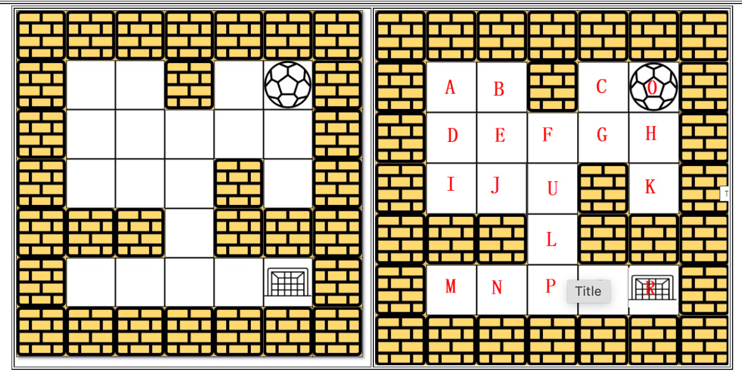
Maze
The ball can go through the empty spaces by rolling right, left, up, down, but it won't stop rolling until hitting a wall. When the ball stops, it could choose the next direction.

Slide 12
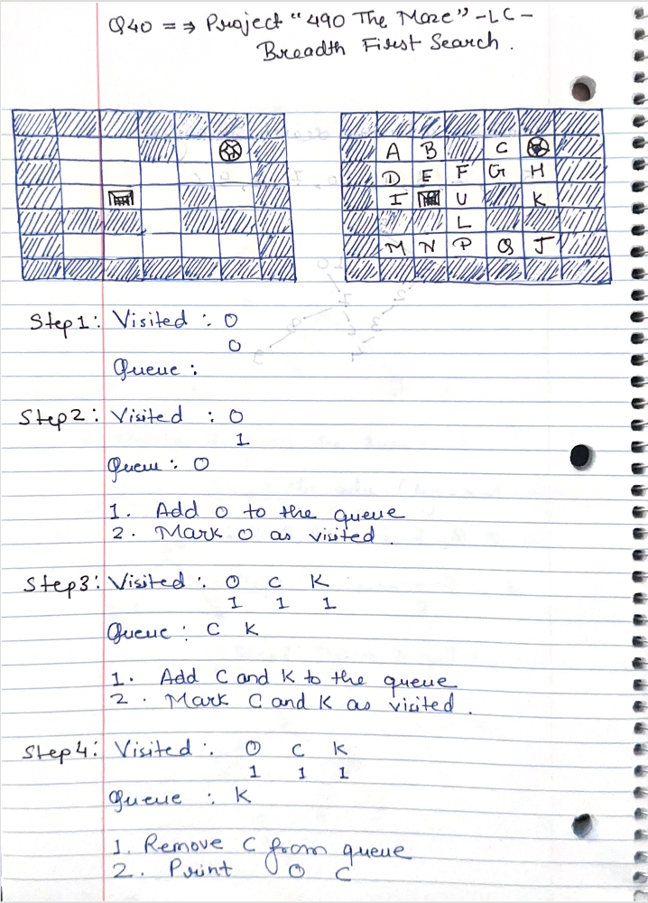
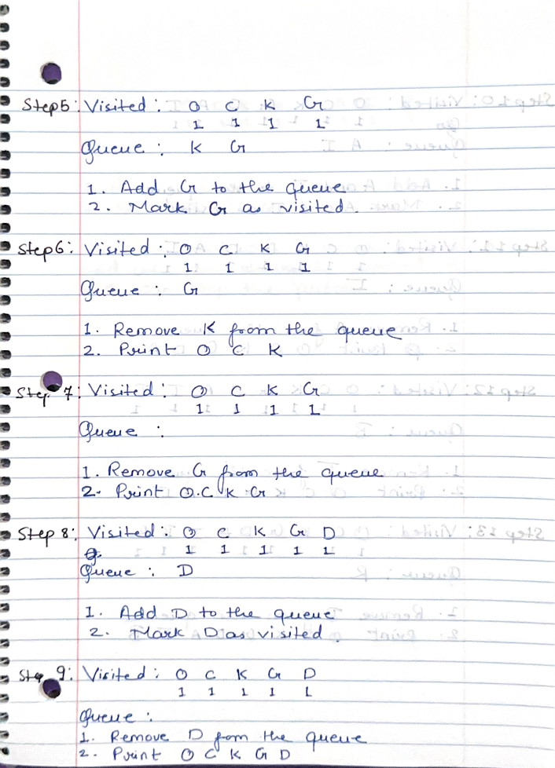

Slide 13
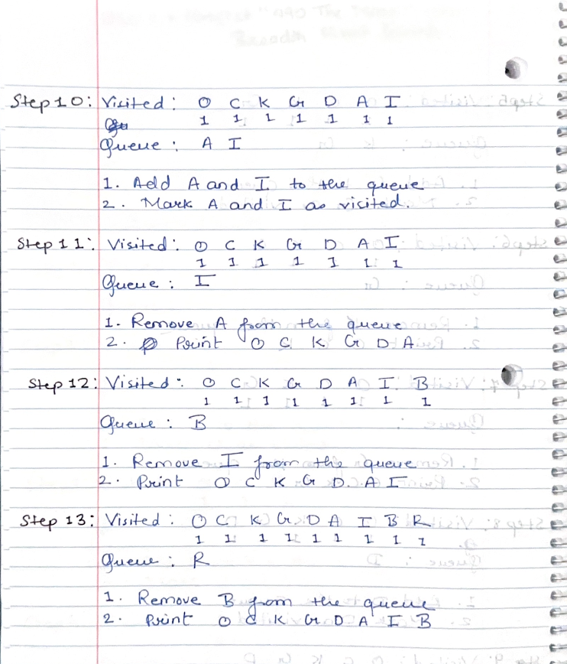
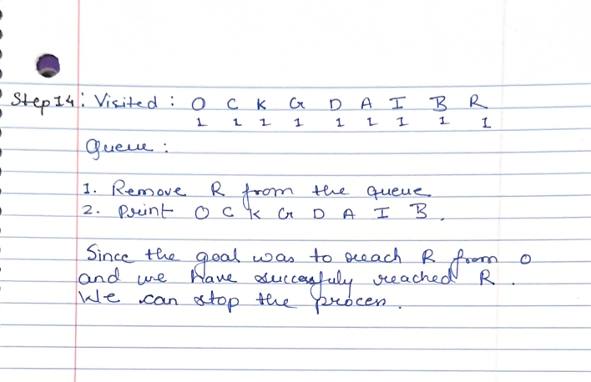

Slide 14
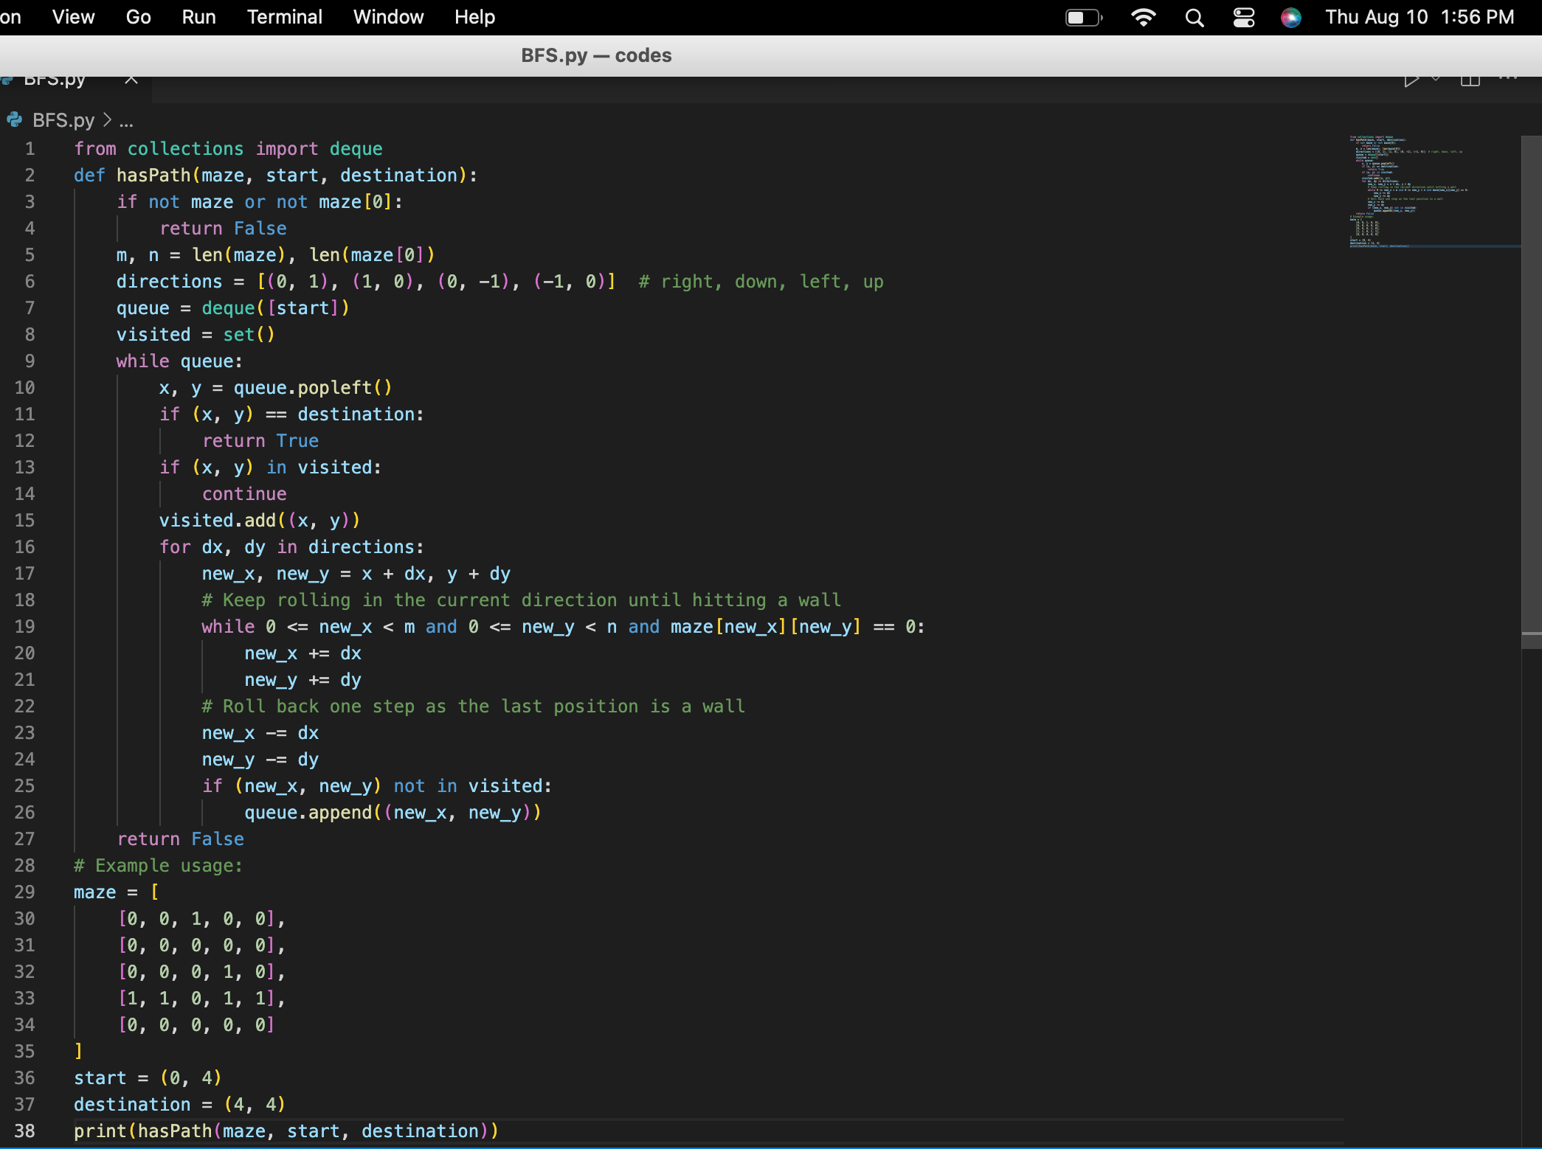
Source Code:

Slide 15
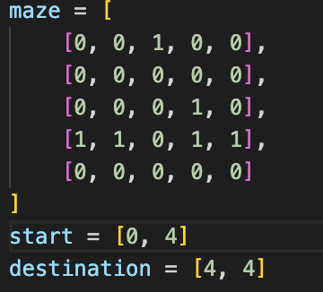
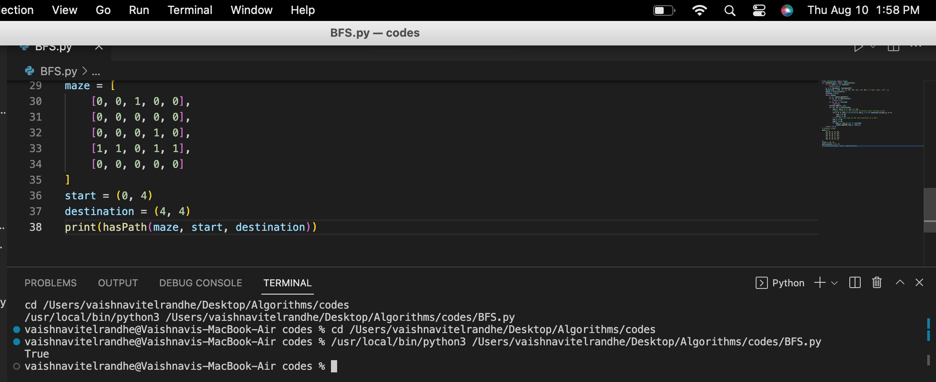
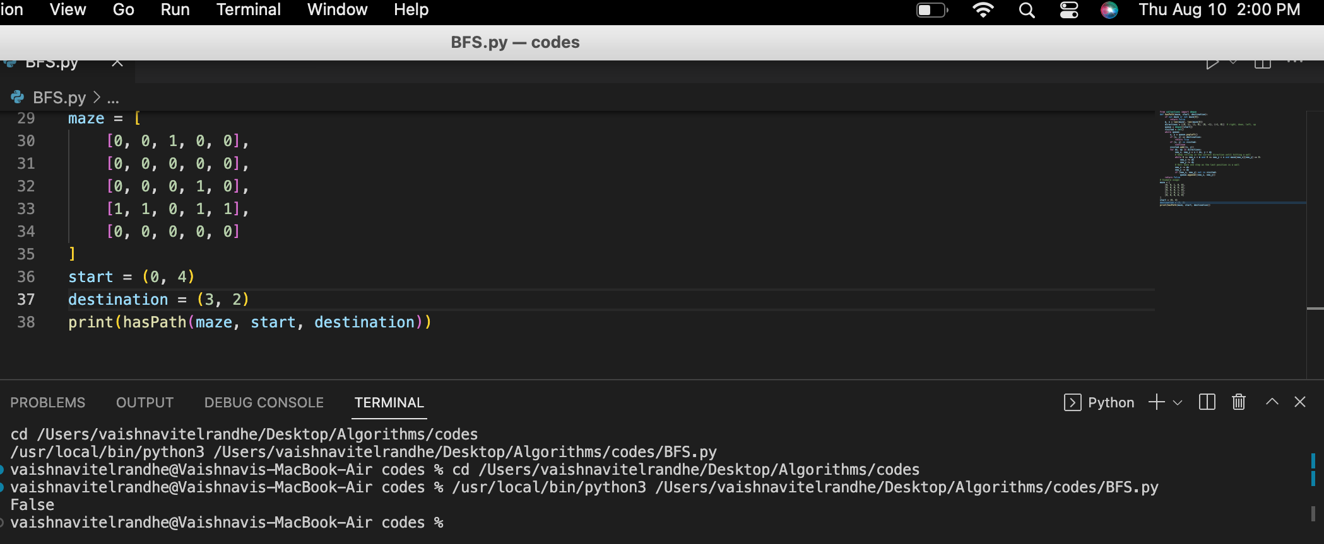
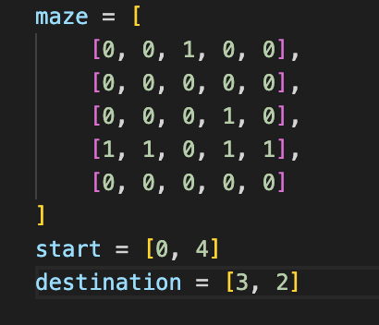
Test Case 1:
Output:
Test Case 2:
Output:

Slide 16
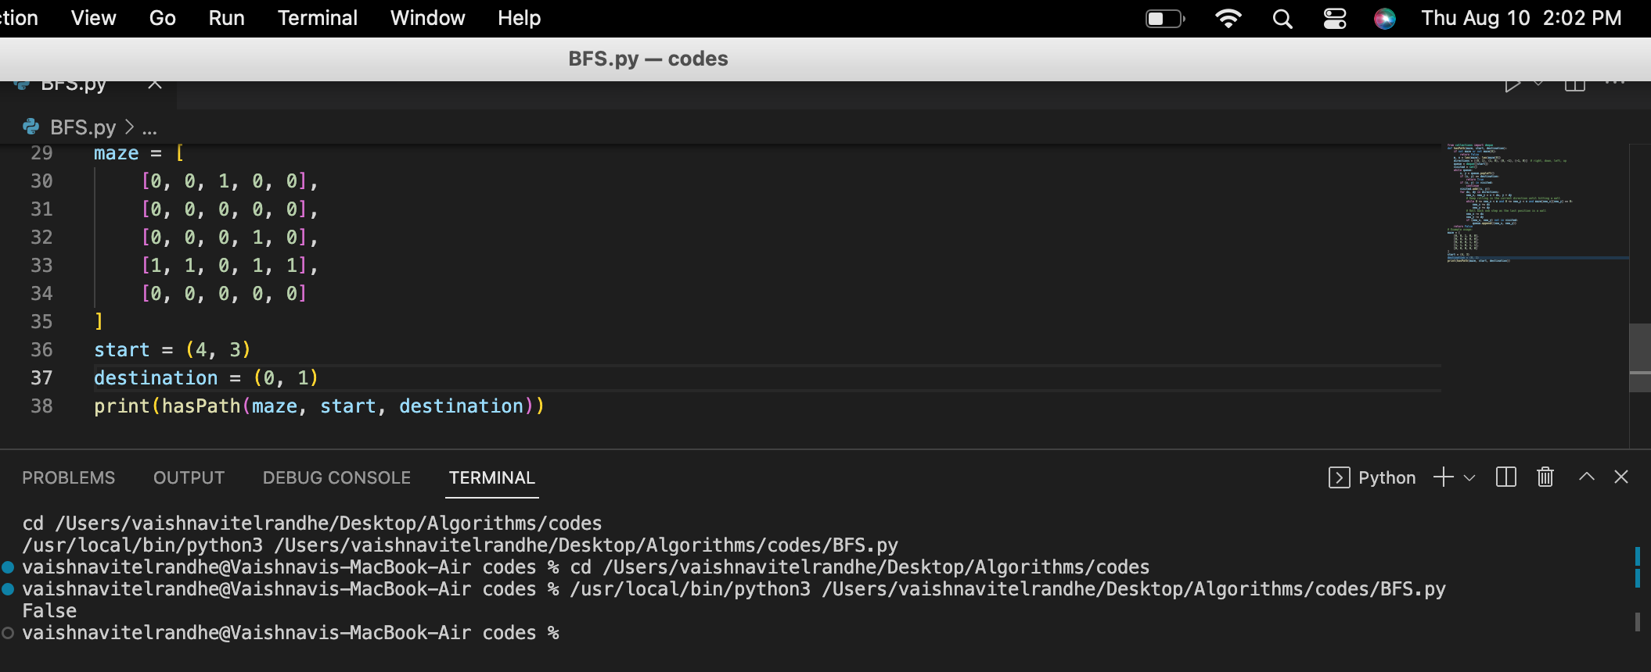
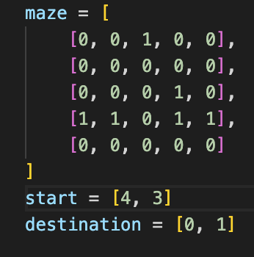
Test Case 3:
Output:

Slide 17
Enhancement Ideas:
Intelligent Pathfinding: Use A* algorithm for faster and optimal exploration with heuristic evaluation.
Dynamic Obstacle Avoidance: Update maze representation to adapt to changing obstacles.
Parallelized Exploration: Utilize multi-core processors for simultaneous maze exploration.
Machine Learning-Based Optimization: Implement neural networks to predict the best exploration direction.
Hierarchical Pathfinding: Divide maze into clusters for efficient exploration.
Memory-Efficient Representations: Use quad-trees or sparse matrices to handle large mazes.

Slide 18
Conclusion
In this research endeavor, we dedicated our efforts to tackle the Leetcode problem 490 - "The Maze" by adopting a highly efficient graph-based approach, complemented by the powerful technique of backtracking. Our relentless exploration of diverse algorithms and the diligent crafting of an optimized solution culminated in the successful development of a method adept at discovering viable paths amidst intricate mazes. Noteworthy outcomes emerged from our investigation, emphasizing the paramount importance of advanced pathfinding algorithms and the systematic methodologies crucial for effective problem-solving.
Throughout the project, the experience was enthralling as we embarked on the journey of devising an ingenious solution to a real-world problem. The exhilaration of witnessing our methods deliver optimal performance was truly gratifying. The process of theoretical comparison and meticulous evaluation bestowed upon us invaluable insights into the dynamic behavior of our algorithm, enabling us to appreciate its adaptability across a myriad of maze scenarios. By the conclusion of this research, we had added meaningful contributions to the realm of maze-solving algorithms and their practical implications.

Slide 19
01.
https://hc.labnet.sfbu.edu/~henry/npu/classes/introjava/project/slide/structure.html
Bibliography
02.
https://medium.com/tech-life-fun/leet-code-490-the-maze-graphical-explained-python3-solution-b4369bbf4050
03.
https://hc.labnet.sfbu.edu/~henry/npu/classes/algorithm/tutorialpoints_dsa/slide/depth_first_traversal.html
04.
https://hc.labnet.sfbu.edu/~henry/npu/classes/capstone/job/slide/portfolio.html
05.
https://hc.labnet.sfbu.edu/~henry/npu/classes/introjava/project/slide/acknowledgement.html
06.
https://hc.labnet.sfbu.edu/~henry/npu/classes/introjava/project/slide/title_page.html
07.
https://hc.labnet.sfbu.edu/~henry/npu/classes/algorithm/graph_alg/slide/maze.html#a2_2
08.
https://hc.labnet.sfbu.edu/~henry/npu/classes/introjava/project/slide/abstract.html

Slide 20
Appendix:

Slide 21
Thank You

